Slide 1
MILESTONE 2
PERLSQUAD

Slide 2
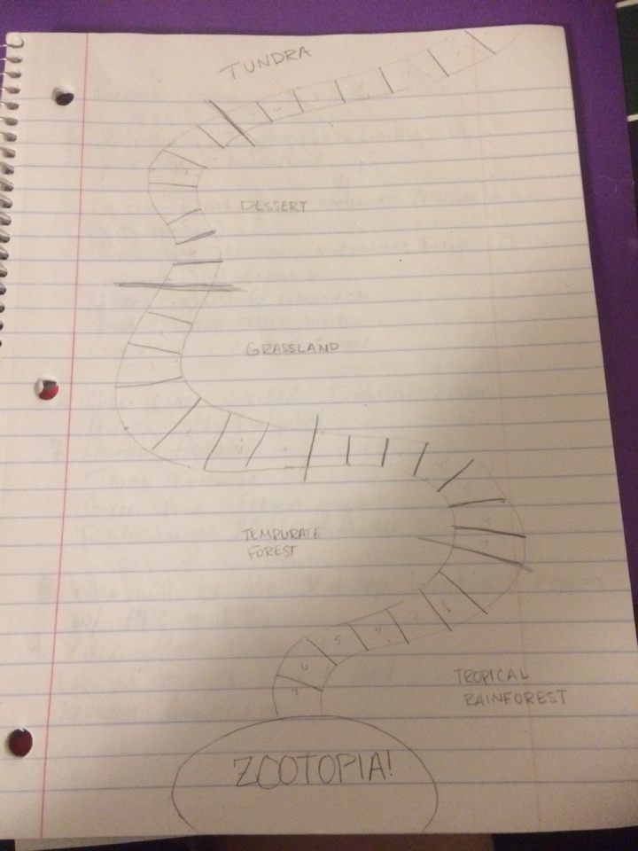
The Specification
A Candy Land-esque board winding through different biomes.
Students will progress through the board, working their way through each Biome
Each piece, within each biome, will have a fun fact concerning animal populations, precipitation, etc..
After landing on such a piece, the player will be given a fun fact, (i.e., Polar bears reside in the tundra) and a “mini-game” to solidify the concept. (i.e., placing the polar bear in the tundra biome)

Slide 3
The Specification
The game will be used to teach, rather than test
For middle school students
Some open questions
How does one win?
Balancing competition with learning
How customizable should it be?

Slide 4


REVISED SYSTEM ARCHITECTURE
HTML5
Will be using the new “canvas” element to render graphics to screen
Javascript
Will be using CreateJS framework to program the game
http://createjs.com/demos/easeljs/spritesheet
Alternatives: Adobe Flash, MIT Scratch

Slide 5
Internal Release Process
Sharing simple HTML files with JavaScript embedded that can be rendered locally
Release every milestone for client feedback, numerous internal releases for each feature
Use GitHub issues to keep track of bugs
Eventually the game can be placed on any website for a major release / deployment

Slide 6
REVISED MINIMUM VIABLE PRODUCT
An aesthetically pleasing playing field in the same vein as “Dora’s Candyland.”
“Mini-games” for each piece
Ex: Picking the right precipitation for the designated biome
Ex: Choosing the right animal for the current biome

Slide 7
Milestones
A board-game style playing field with one movable player
One “mini-game”
Extend mini-games to all pieces and support multiple players
Make everything (images, board, animations) look pleasing

